Slide 1
Personalized Healthcare Recommendations System
Domain: Healthcare Analytics
Technology: Machine Learning
Tools: Python (Jupyter Notebook, VS Code)
Prepared by : Gayatri Raghunath Kulkarni
UNID: UMID05112569400

Slide 2
Project Overview
Healthcare datasets contain important blood and clinical indicators.
Personalized recommendations help improve patient outcomes.
This project uses machine learning to generate tailored healthcare advice.
Goal: Provide preventive and lifestyle/medication suggestions using patient health data.

Slide 3
Problem Statement
Patients have different medical histories and lifestyle conditions.
A single treatment approach does not work for everyone.
Need an intelligent system that predicts personalized healthcare recommendations.
Solution: ML-based recommendation model trained on blood/health indicators.

Slide 4
Dataset Description
Dataset includes patient health parameters such as:
Age, Gender
Blood Pressure
Cholesterol Levels
Heart Rate
Smoking Status
Exercise Level
Medical Lab Results
Dataset Source: Blood healthcare dataset (provided in project document).

Slide 5
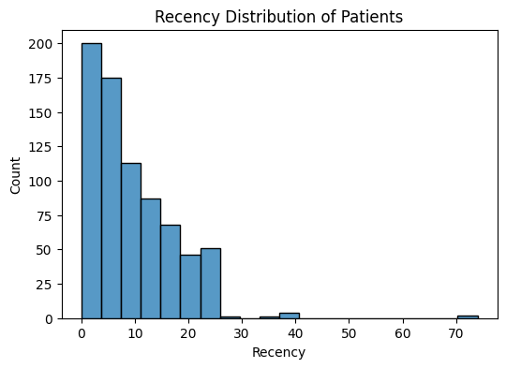
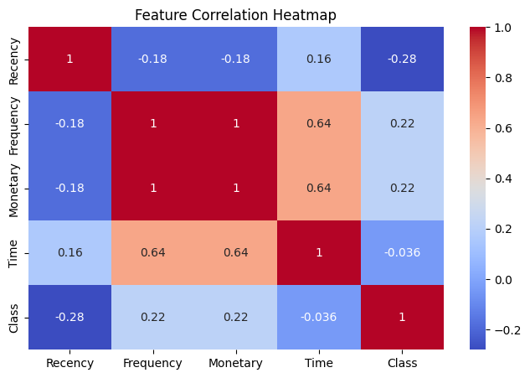

Slide 6
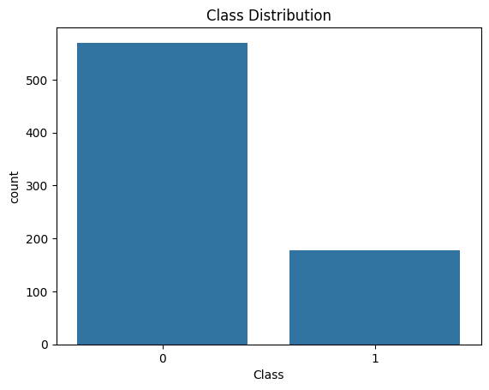

Slide 7
Project Workflow
Steps followed in the project:
Understanding the healthcare recommendation problem
Dataset collection and preparation
Data exploration & visualization
Data preprocessing
Feature engineering
Model selection and training
Model evaluation
Recommendation generation

Slide 8
Data Exploration & Visualization
Python libraries used:
Pandas (data handling)
Matplotlib & Seaborn (visualization)
Visualizations created:
Age distribution histogram
Correlation heatmap
Recommendation category countplot
Purpose: Identify patterns, trends, and feature relationships.

Slide 9
Data Preprocessing
Preprocessing techniques applied:
Handling missing values
Normalizing continuous features
Encoding categorical variables using One-Hot Encoding
Splitting dataset into training and testing sets
Ensures clean and model-ready data.

Slide 10
Machine Learning Model Used
Model selected: Random Forest Classifier
Reasons:
High accuracy on healthcare datasets
Handles complex feature interactions
Robust against overfitting
Other models considered:
Logistic Regression
Decision Trees
Gradient Boosting
Support Vector Machines

Slide 11
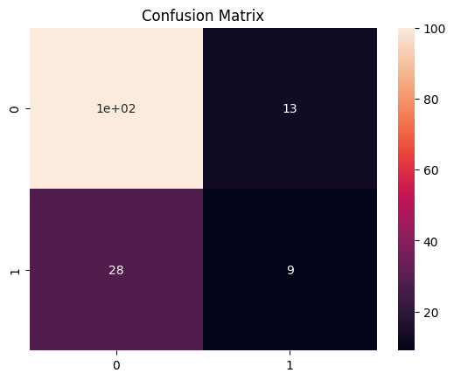
Model Evaluation
Evaluation metrics used:
Accuracy
Precision
Recall
F1-score
Confusion Matrix
ROC-AUC Curve
Visualization:
Confusion matrix heatmap for performance analysis

Slide 12
Personalized Recommendation System
System predicts healthcare actions such as:
No action needed
Regular check-up
Lifestyle changes
Medication support
Example:
Input: Patient BP, Cholesterol, Lifestyle
Output: Personalized healthcare recommendation

Slide 13
Results & Key Insights
Model successfully classifies patient recommendation categories.
Lifestyle factors significantly impact prediction outcomes.
Random Forest achieved strong performance with balanced accuracy.
Insights help clinicians and patients take preventive steps early.

Slide 14
Conclusion & Future Scope
Conclusion:
ML-based healthcare recommendation improves personalized treatment planning.
Provides actionable and interpretable healthcare guidance.
Future Enhancements:
Integrating wearable device real-time data
Using Explainable AI (SHAP/LIME)
Deploying system with Flask/Django as a web app
Expanding dataset for higher accuracy
Ref this link for code ref of this project : personalized helathcare recommendation system – Colab

